Slide 1
CAR PRICE PREDICTION
BY
V TARAK RAM SAI

Slide 2
PROBLEM STATEMENT
This is regarding a client who works with small traders to sell used cars. The focus of this project is developing machine learning models that can accurately predict the price of a used car based on its features.
Deciding whether a used car is worth the posted price when you see listings online can be difficult. Several factors, including mileage, make, model, year, etc. can influence the actual worth of a car.
From the perspective of a seller, it is also a dilemma to price a used car appropriately. Based on existing data, the aim is to use machine learning algorithms to develop models for predicting used car prices.

Slide 3
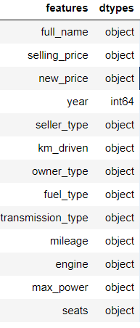
Data Description
full_name: Brand and model of the Car.
selling_price: The price of the used car.
year: Year of the car that is bought.
seller_type: Seller type of the car(Individual or Dealer)
km_driven: Total kilometres that car has travelled.
owner_type: It describes the no. of people who used the car.
fuel_type: Type of fuel that car runs by.
mileage: Mileage of the car.
engine: CC of car’s engine.
max_power: Maximum power of the car.
seats: Total seats in the car.

Slide 4
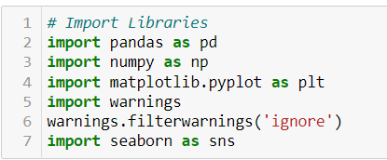
Data Pre-Processing
It entails converting raw data into comprehensible format that a machine learning model can understand. The data pre-processing involves data cleaning which involves handling missing values, transformation of data i.e. normalizing the data and data reduction which involves only required features.

Slide 5
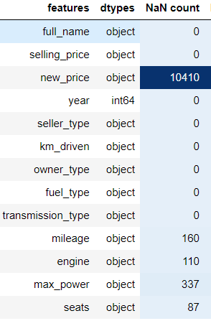
Data Cleaning
The first step of pre-processing is data cleaning by checking and eliminating any missing values because they affect the accuracy of the model. This is achieved by either filling the missing values with a mean or mode function or by dropping all the missing values. In this case, there are missing values in new_price, mileage, engine, max_power and seats columns.

Slide 6
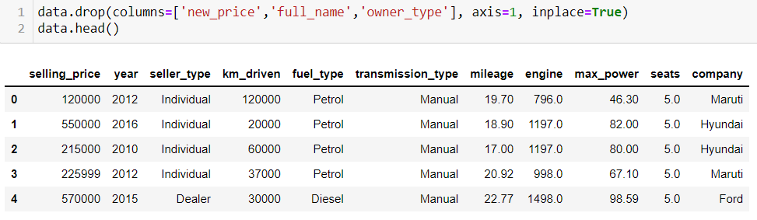
Data Reduction
The next step of data processing is data reduction. This is used to remove duplicate features present in the data i.e. unwanted features for prediction.

Slide 7
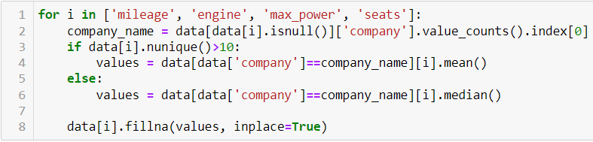
Handling Missing Values
The problem of missing value is quite common in many real-life datasets. Missing value can bias the results of the machine learning models and/or reduce the accuracy of the model.

Slide 8
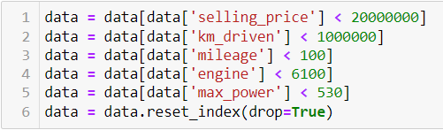
Handling Outliers
Outliers are data points that don't fit the pattern of rest of the numbers. They are the extremely high or extremely low values in the data set.
A simple way to find an outlier is to examine the numbers in the data set. We will see that most numbers are clustered around a range and some numbers are way too low or too high compared to rest of the numbers. Such numbers are known as outliers.

Slide 9
Encoding
Encoding categorical data is a process of converting categorical data into integer format so that the data with converted categorical values can be provided to the different models.
Encoding is a required pre-processing step when working with categorical data for machine learning algorithms.

Slide 10
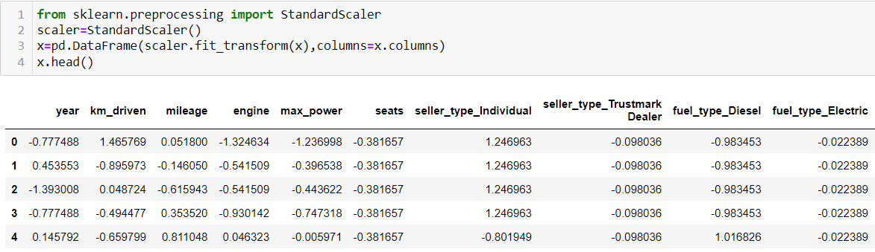
Scaling
Feature scaling is a method used to normalize the range of independent variables or features of data. To convert data into a distribution with a mean of 0 and standard deviation of 1, we will use a standard scalar.

Slide 11
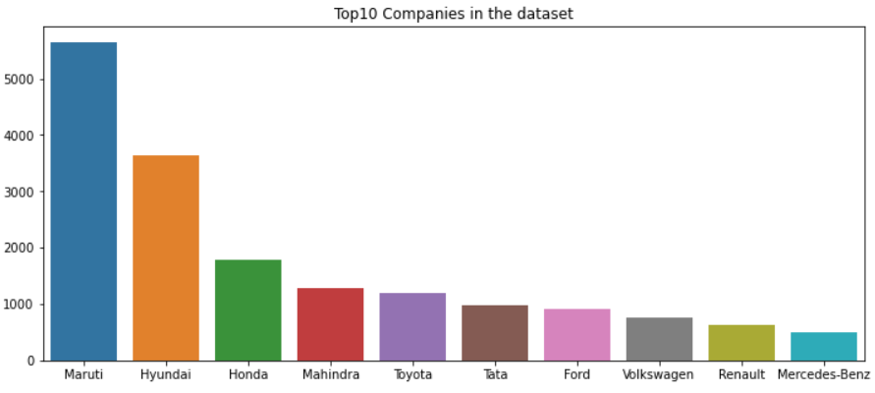
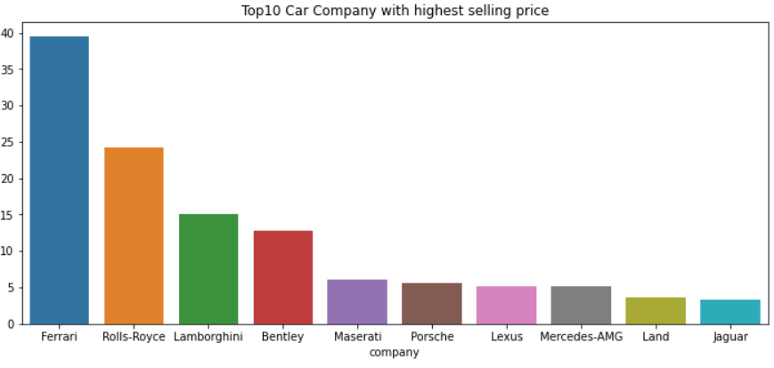
Data Inputs- Logic- Output Visualization
These are the Top 10 companies present in the dataset.
These are the Top 10 companies with highest selling price.

Slide 12
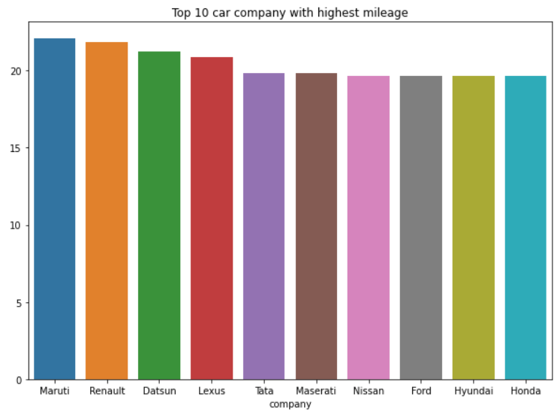
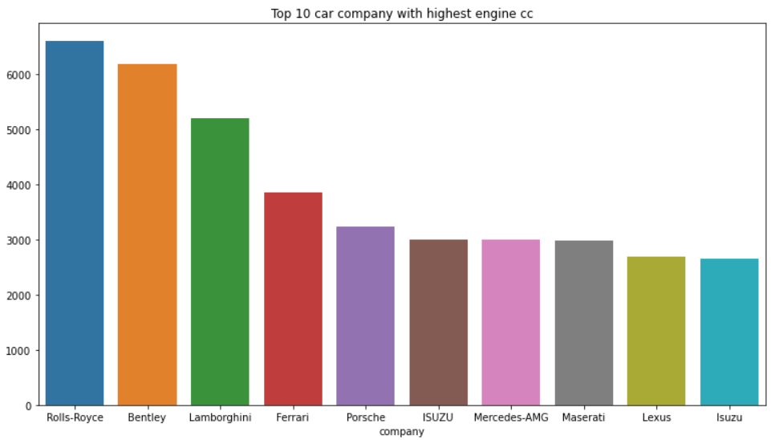
Data Inputs- Logic- Output Visualization
These are Top 10 car companies with highest mileage.
These are Top 10 car companies with
highest engine cc.

Slide 13
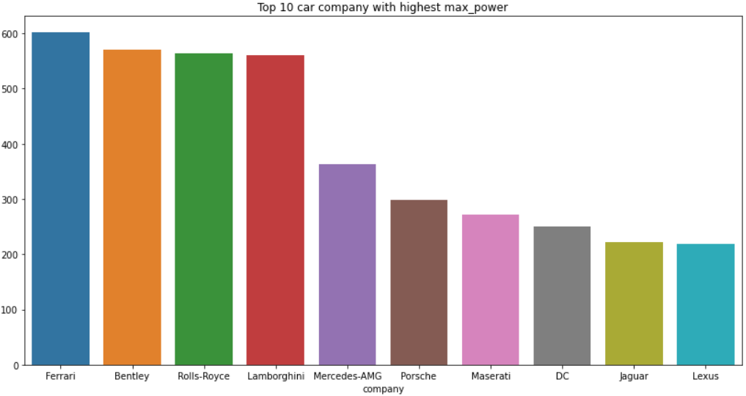
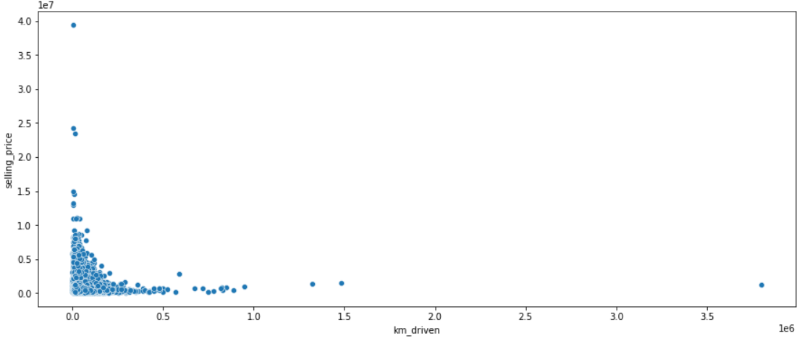
Data Inputs- Logic- Output Visualization
These are Top 10 car companies with highest maximum power.
If kilometres driven is more, then the
selling price of the car will be less.

Slide 14
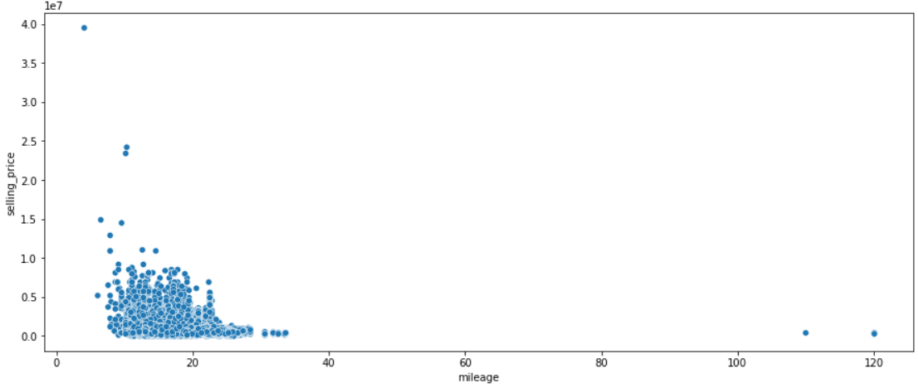
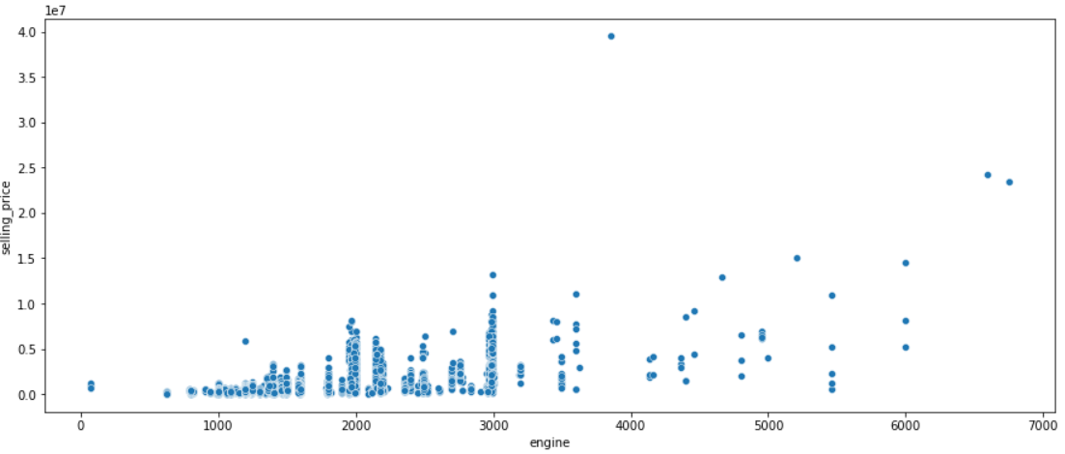
Data Inputs- Logic- Output Visualization
There is no significant relation between mileage and selling price of the car. In some cases, higher the mileage lower is the selling price.
If the engine's cc is more, then the selling
price of the car is also more.

Slide 15
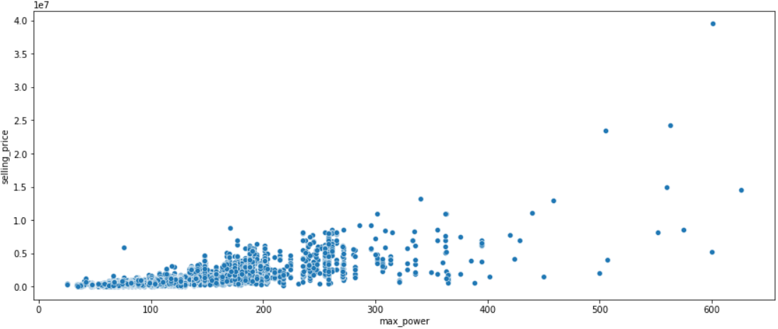
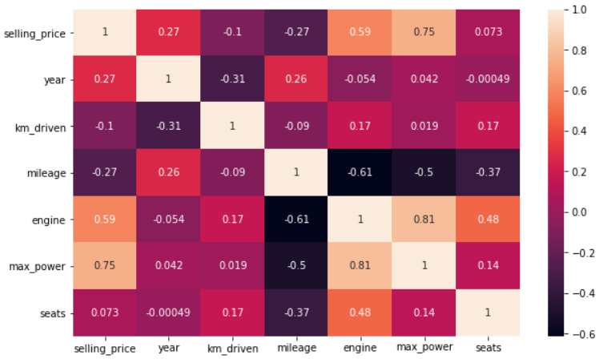
Data Inputs- Logic- Output Visualization
If the power of the engine is more, then the selling price of the car is also more.
The correlation between the variables
is as shown in the figure.

Slide 16

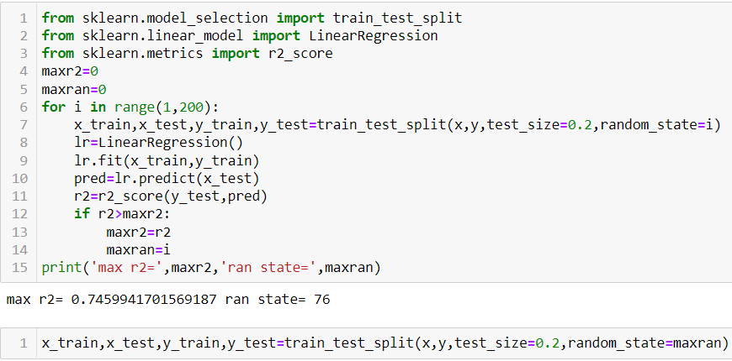
Model/s Development and Evaluation
The independent variables are declared in x and the dependent variable i.e. ‘selling_price’ is declared in y as follows-
The code is done for choosing the
Random state variable. We should
do testing by using any of the four
classification algorithms.

Slide 17
Hyper Parameter Tuning
In machine learning, hyper parameter optimization or tuning is the problem of choosing a set of optimal hyper parameters for a learning algorithm. A hyper parameter is a parameter whose value is used to control the learning process. By contrast, the values of other parameters (typically node weights) are learned.
Hyperparameter tuning is choosing a set of optimal hyperparameters for a learning algorithm. A hyperparameter is a model argument whose value is set before the learning process begins. The key to machine learning algorithms is hyperparameter tuning.

Slide 18
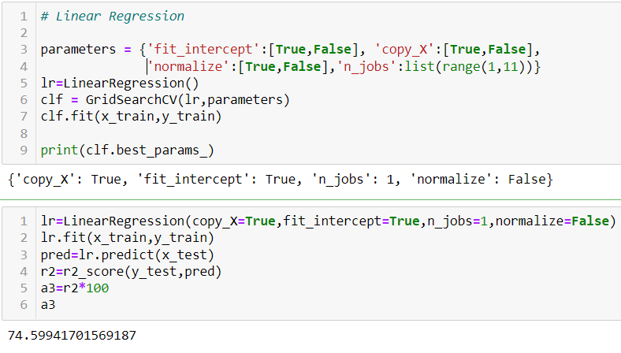
Linear Regression
Linear Regression attempt to model the relationship between two variables by fitting a linear equation to observed data. The other is considered to be dependent variable.

Slide 19
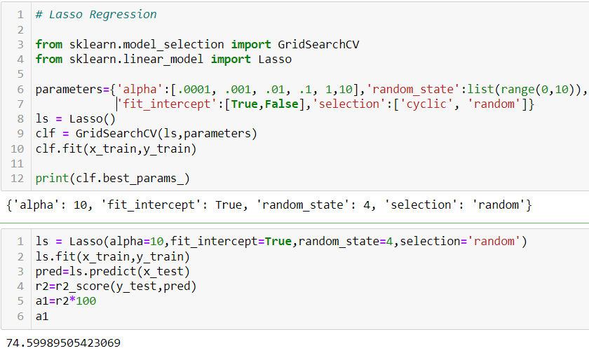
Lasso Regression
The “LASSO” stands for Least Absolute Shrinkage and Selection Operator. Lasso regression is a regularization technique. It is used over regression methods for a more accurate prediction.
This model uses shrinkage. Shrinkage is where data values are shrunk towards a central point as the mean. The lasso procedure encourages simple, sparse models (i.e. models with fewer parameters).

Slide 20
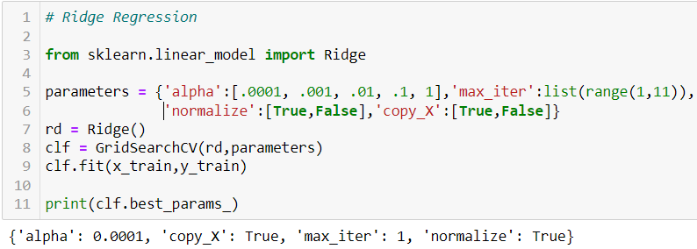
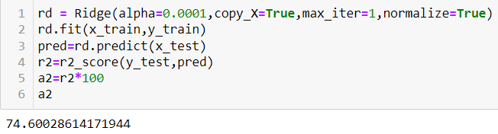
Ridge Regression
A Ridge regressor is basically a regularized version of Linear Regressor. The regularized term has the parameter ‘alpha’ which controls the regularization of the model i.e. helps in reducing the variance of the estimates.

Slide 21
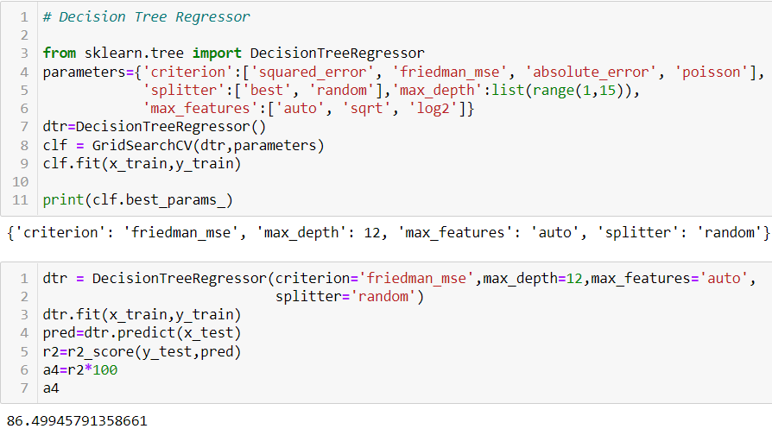
Decision Tree Regression
Decision tree builds regression or classification models in the form of a tree structure. It breaks down a dataset into smaller and smaller subsets while at the same time an associated decision tree is incrementally developed. The final result is a tree with decision nodes and leaf nodes.

Slide 22
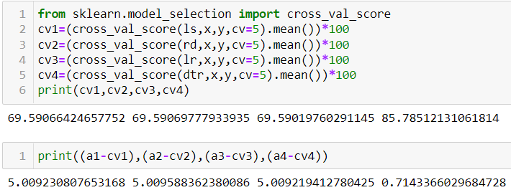
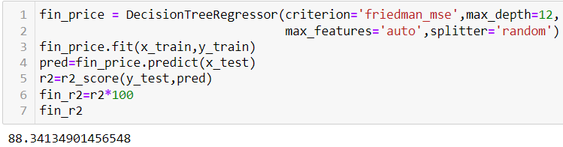
Cross Validation
Cross Validation is a very useful technique for assessing the effectiveness of your model, particularly in cases where you need to mitigate overfitting.
We can choose Decision Tree Regression as our model since its cross validation score and accuracy score are almost similar.

Slide 23
Key Findings and Conclusions of the Study
The results of our tests were quantified in terms of the R score of our predictions. R2 score is a statistical measure of how close the data are to the fitted regression line. Compared to Linear Regression, Decision-Tree based methods performed comparably well.
Car price prediction can be a challenging task due to the high number of attributes that should be considered for the accurate prediction. The major step in the prediction process is collection and preprocessing of the data. In this research, PHP scripts were built to normalize, standardize and clean data to avoid unnecessary noise for machine learning algorithms.

Slide 24
Key Findings and Conclusions of the Study
Data cleaning is one of the processes that increases prediction performance, yet insufficient for the cases of complex data sets as the one in this research. Applying single machine algorithm on the data set accuracy was about 75%.
Therefore, the ensemble of multiple machine learning algorithms has been proposed and this combination of ML methods gains accuracy of 88 %. This is significant improvement compared to single machine learning method approach.
For better performance, we plan to judiciously design deep learning network structures, use adaptive learning rates and train on clusters of data rather than the whole dataset.
However, the drawback of the proposed system is that it consumes much more computational resources than single machine learning algorithm.

